Slide 1
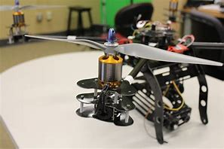
Propellers
Generating Thrust with a Propeller
LabRat Scientific
2018 ©

Slide 2
Airplane/Drone propellers are devices that impart momentum to a fluid (air). To understand how a propeller works we need to understand the basics of momentum.
Momentum = Mass * Velocity
Momentum is generally depicted as “p”, so the general equation becomes:
p = mv

Slide 3
Aeronautical Engineers refer to the circular area swept out by the propeller as the “actuator disk”. The spinning propeller accelerates the gas molecules as they move across the disk. Acceleration implies higher velocity, which in turn, means higher momentum…
Actuator Disk
Low Momentum (possibly zero…)
High Momentum

Slide 4
Simply put, when the propeller imparts momentum to the air, it produces thrust, which is a force that moves the airplane forward.
A true understanding of the concept requires us to dig a little deeper into what is really going on. To be more precise, the force comes about when the propeller “changes the momentum” of the gas molecules from zero velocity to some non-zero velocity.
That said, how does this “change in momentum” mathematically relate to force?

Slide 5
Engineers and scientists view the “change” in something over time as a derivative (from calculus). In this case, the change in momentum over time can be mathematically depicted as follows:
Change in Momentum dp
Force = ------------------------------ = --------
Change in Time dt
Recall that in calculus, the “d” in the equation represents the “change”. So “dp” is the change in momentum, and “dt” is the change in time.

Slide 6
Graphical Representation of Momentum Change due to the Propeller Actuator Disk:
The figure at the right shows momentum of a gas molecule just before it passes through the actuator disk at t₁, and just after it leaves the disk a short time later at t₂.
p₂
Momentum
Rise
Run
p₁
Recall from geometry that “rise” over “run” is the slope of the line.
t₁
t₂
Time
This means that the slope of the momentum line (a.k.a. derivative) is the force being generated by the propeller.

Slide 7
Let’s prove that the change in momentum does indeed result in a force
We will start with Newton’s 2nd Law of Motion:
F = ma
We know that acceleration “a” is the change in velocity over a change in time:
dv
Acceleration = a = -------
dt
So Newton’s 2nd Law can be rewritten as follows:
dv
F = m -------
dt

Slide 8
Applying some basic calculus properties we can move the “m” to the numerator of the derivative:
dv d(mv)
F = m -------- = ---------
dt dt
From earlier, we know that mv = p = momentum. Substituting “p” for “mv” we get:
dp
F = --------
dt
So, starting with Newton’s 2nd Law of motion, we have derived the force equation based on the change in momentum. So looks like the math works out.

Slide 9
We can now state that:
d (mv)
---------- = ma
dt
Let’s check the units to make sure they are correct:
d (mv) (kg * m/sec)
---------- = ---------------- = Kg * m/sec² = N
dt sec
ma = kg * m/sec² = N
Yep, Mass x Accel is a Force (N)…

Slide 10
We have still not really determined why the drone rises when the propellers are turned on. In the previous analysis, the thrust that was created by the change in momentum was in the direction that the particles were accelerated.
Put another way, the gas molecules were “thrust downward”.
Actuator Disk
Molecules with “changed” momentum
Thrust
So what makes the drown move upwards?

Slide 11
To answer this, we need to consider Conservation of Momentum, which is related to Newton’s 3rd Law of Motion:
“For every action there is an equal and opposite reaction”
As the propeller (a.k.a actuator disk) imparts momentum to the gas molecules, an equal and opposite momentum is imparted to the propeller (and thus the drone).
As a result, the upward force is equal and opposite of the downward thrust force.

Slide 12
The drone moves upwards due to Newton’s 2nd Law of Motion:
F
F = ma a = ------
m
The upward force creates an acceleration in the upwards direction and the drone moves upwards…

Slide 13
An interesting experiment can be conduced to demonstrate the Conservation of Momentum concept. Obviously flying the drone upwards demonstrates the concept, but let’s go one step farther.
What if we configure the drone in such a way that the momentum imparted to the gas molecules was immediately imparted back into the drone?
Will the drone fly?
Light weight reaction plate attached to the legs of the drone.

Slide 14
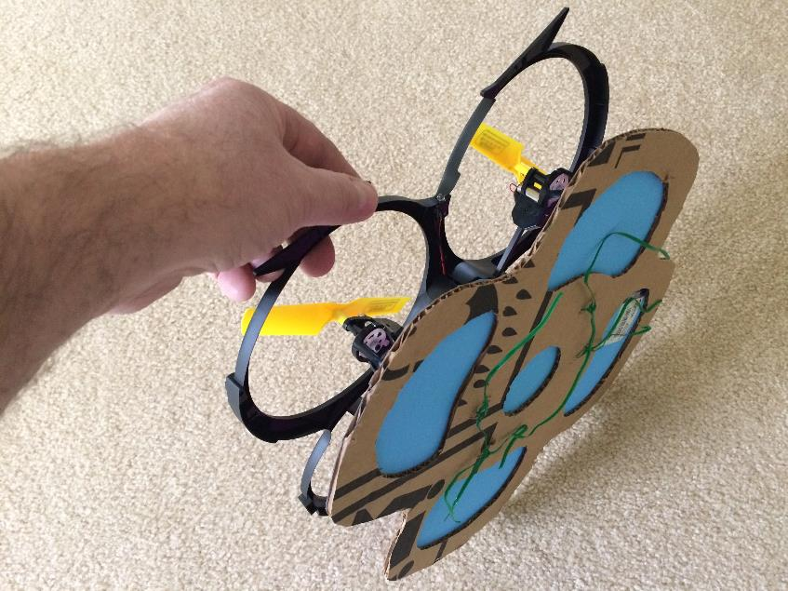
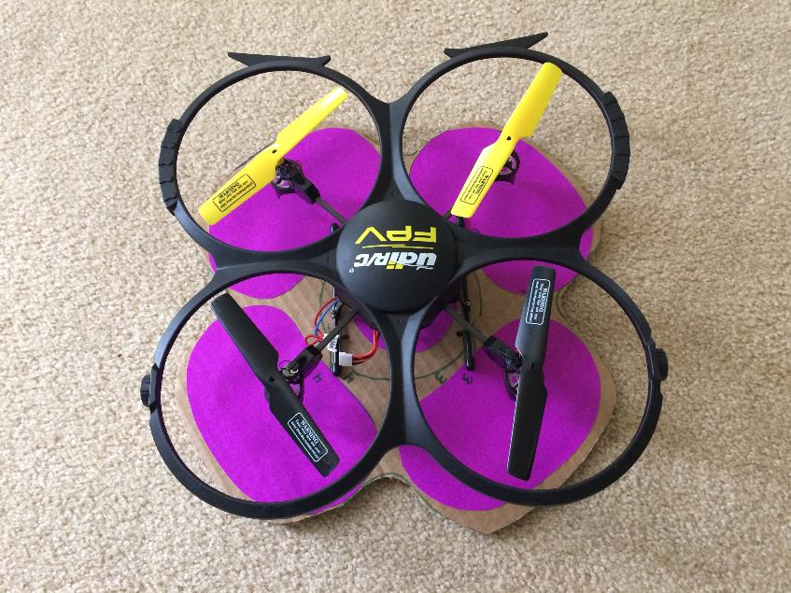
The Experimental Set-up
A light weight frame made out of corrugated cardboard. The cut outs are covered by even lighter poster board. An initial test was conduced to determine how much weight the drone could lift and the reaction plate was made much lighter.

Slide 15
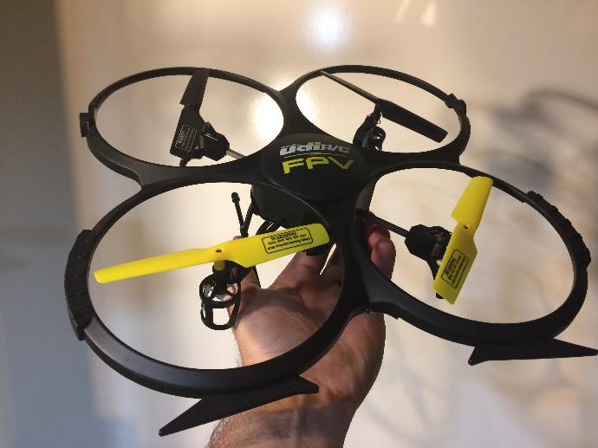
From experiments it was determined that the test drone (picture at right) was capable of lifting its own mass (160 g) plus an additional 80 grams of payload.
System Weight_{Drone} = 240 g = 0.24 kg
Since this is the maximum mass the drone can lift, we can calculate the maximum force being generated by the 4 propellers:
Force = Mass * Gravity Accel
= 0.24 kg * 9.8 m/sec²
= 2.4 N

Slide 16
Since we know the maximum lifting force that the drone can produce, we know the change in momentum being caused by the drone propellers:
Change in Momentum = Thrust = 2.4 N
The air being driven down by the propeller will flow down and impart it’s momentum to the reaction plate. So, if momentum is conserved, a total of 2.4 N of momentum will be imparted downward on the plate.

Slide 17
Momentum imparted to the gas by the propellers
Momentum imparted on the reaction plate by the moving gas

Slide 18
Upward Force
Downward Force
If the forces are equal and opposite, Newton says the drone will not move. If the drone does not move, it means the momentum imparted to the air by the propellers is 100% transferred to the reaction plate…

Slide 19
Watch the LabRat video to see the results from the experiment.

Slide 20
Questions?

